Slide 1
3- Ternary Operator

Slide 2
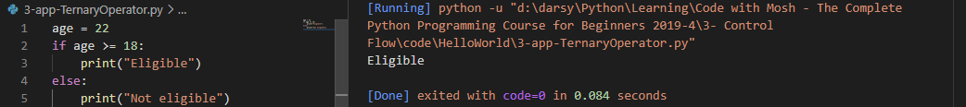
I'm gonna show you a technique for writing cleaner code.
we're building an application for a university and we wanna check to see if the person who's applying for this university program is eligible or not.

Slide 3
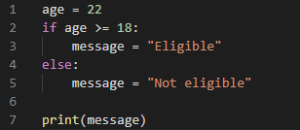
I want to show you a cleaner way to achieve the same result.
when you have an if else statement with this structure where you're basically assigning a value to a variable, you can rewrite this in a simpler way.

Slide 4
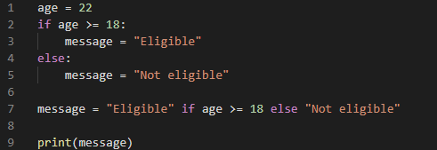
This statement is almost like plain English

Slide 5
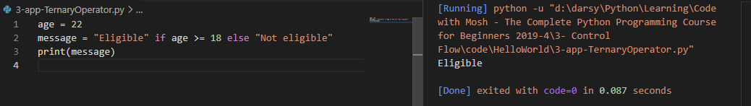

Slide 6
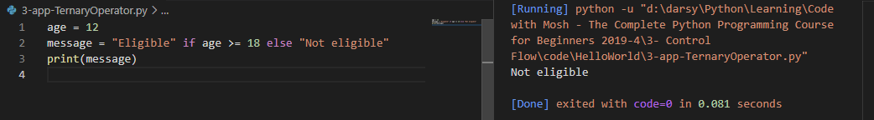

Slide 7
So what we have here is called ternary operator.

